Slide 1
Imbalanced datasets
By
Dr. S PADMANABHAN

Slide 2
Balanced dataset
A balanced dataset is one where each class in the target variable is represented equally or nearly equally.
In classification tasks, having a balanced dataset is important because it helps ensure that the model can learn to identify patterns associated with each class equally well.
A balanced dataset prevents the model from becoming biased towards predicting the majority class, which can happen in cases of class imbalance.

Slide 3
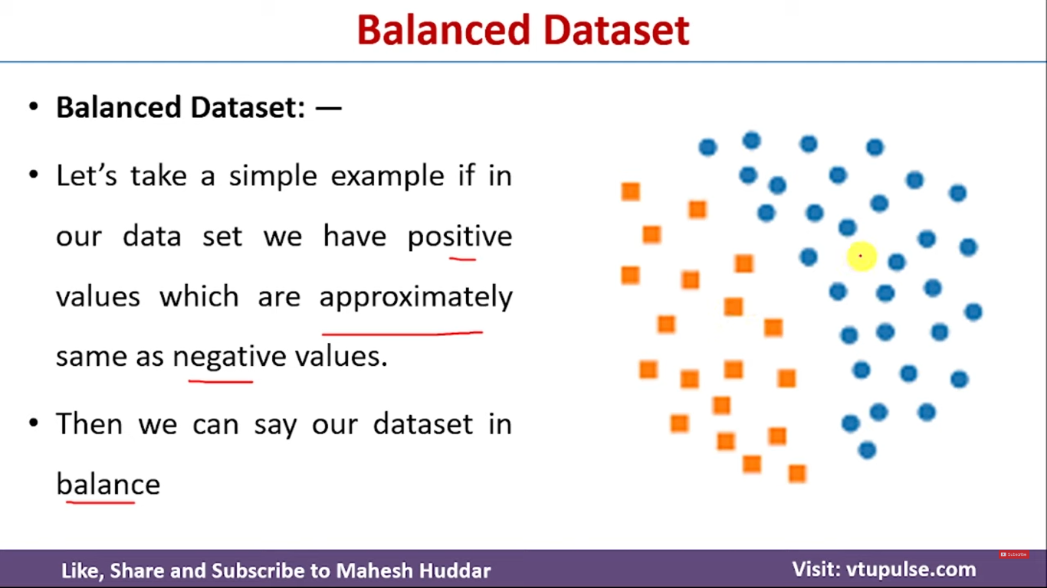

Slide 4
Imbalanced dataset
Imbalanced Dataset “also called an unbalanced dataset ” refer to datasets where the observations or target class is skewed or has uneven distribution. This means that one class label has a very fewer number of observations and the other has very high numbers of observations.

Slide 5

Imbalanced datasets

Slide 6
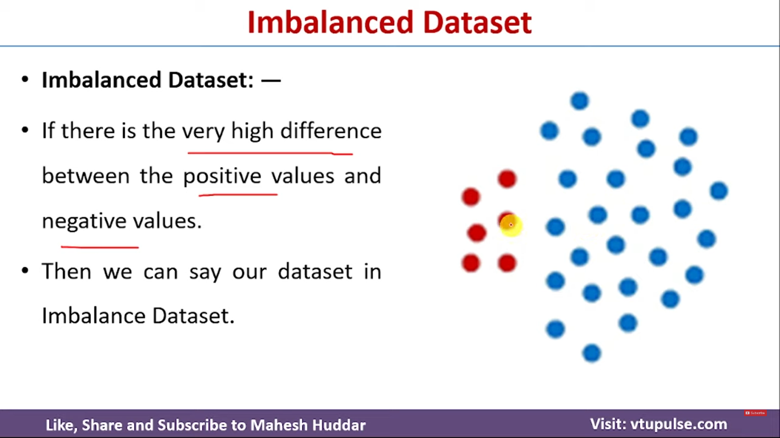

Slide 7
Imbalanced dataset
Imbalanced datasets are a common issue in machine learning, particularly in classification problems. When one class significantly outnumbers the other(s), it can lead to biased models that favour the majority class. Managing imbalanced datasets effectively is crucial to ensure that the model performs well across all classes, not just the majority ones.

Slide 8
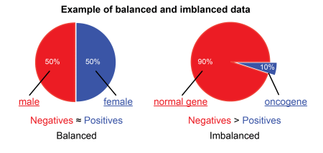

Slide 9
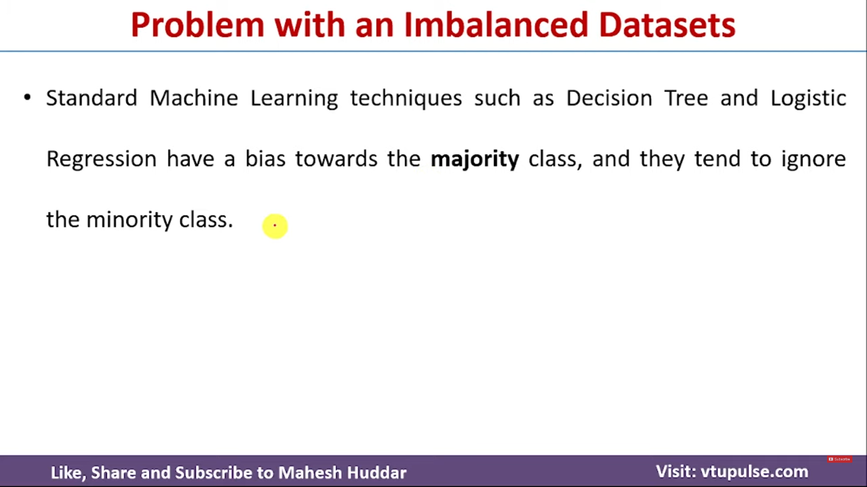

Slide 10
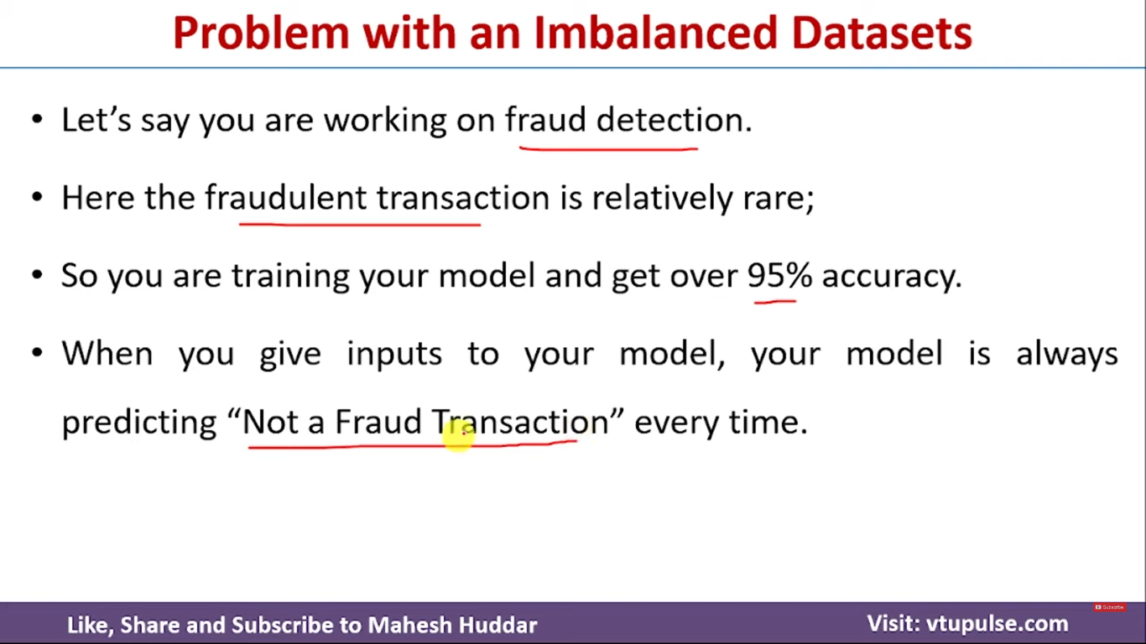

Slide 11
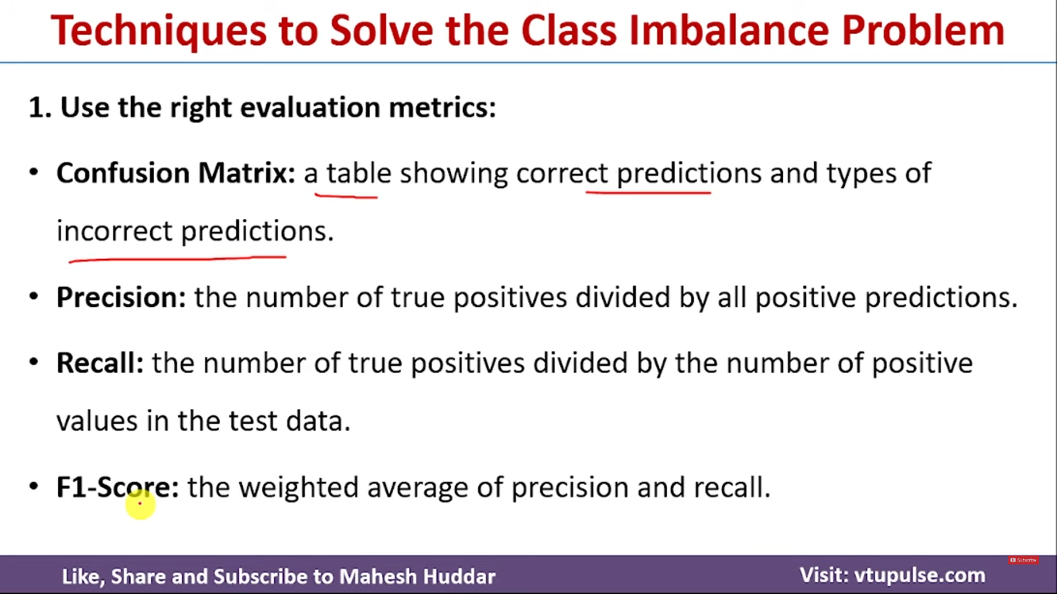

Slide 12
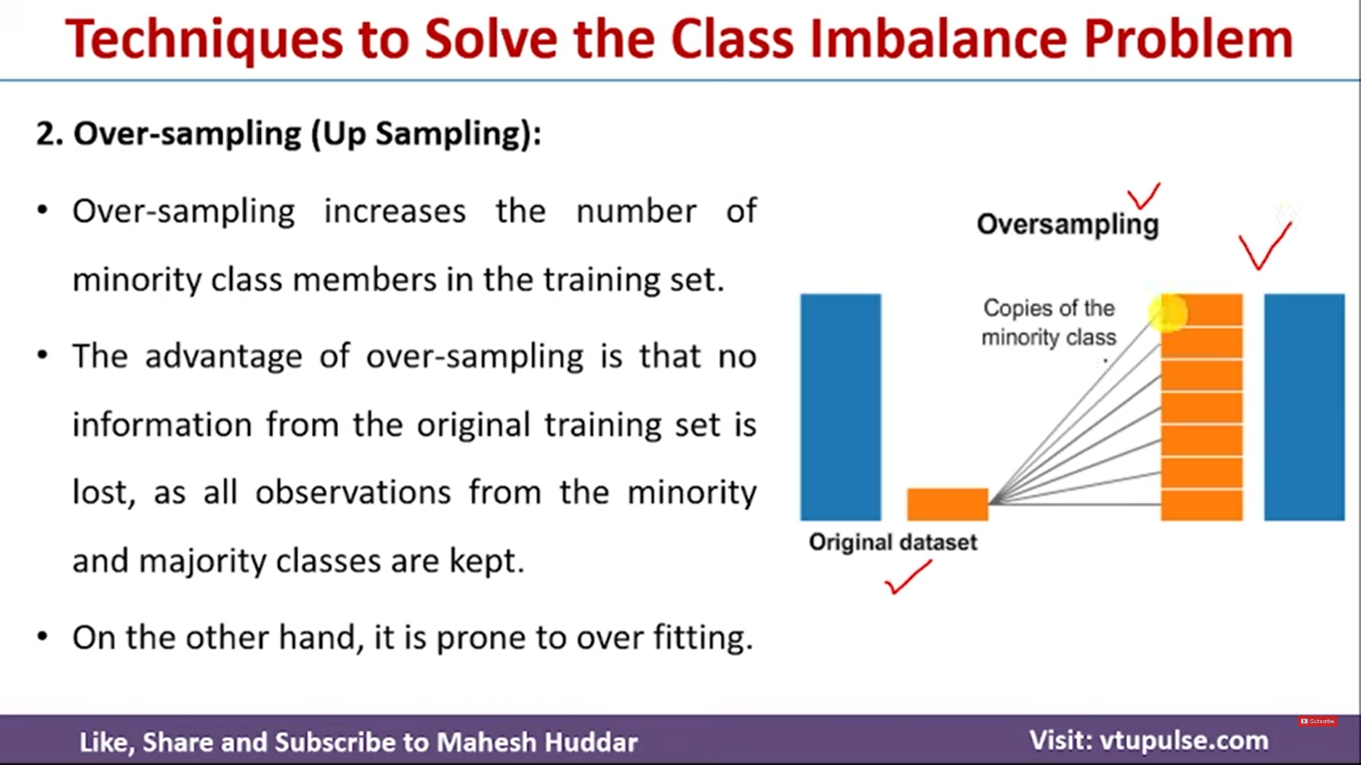
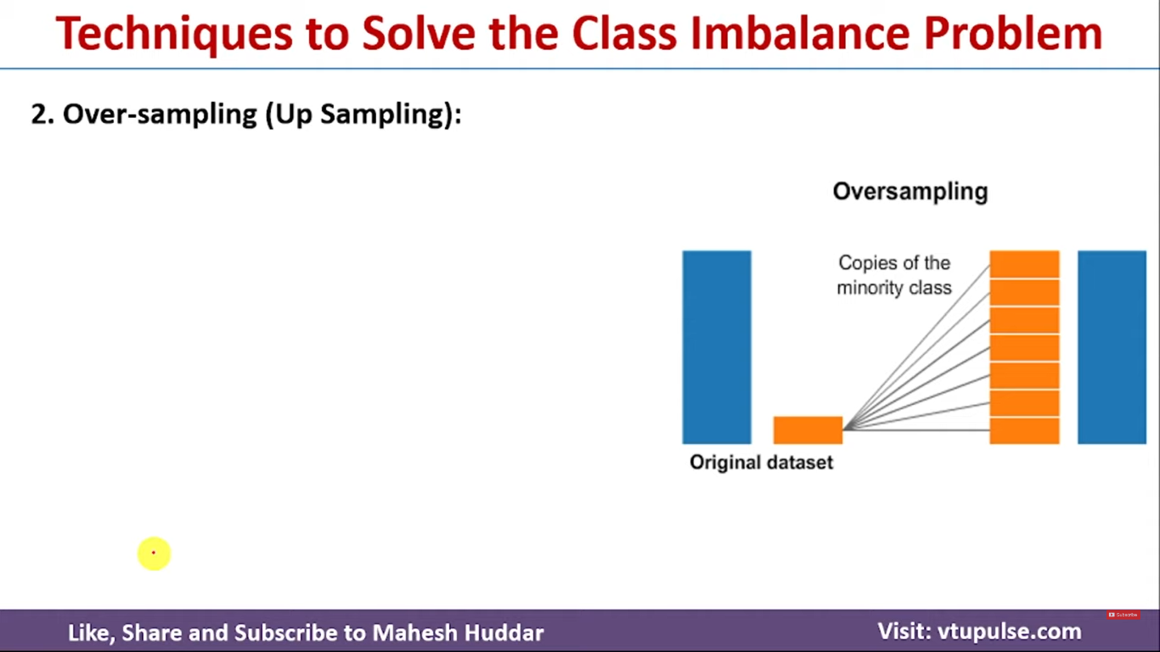

Slide 13
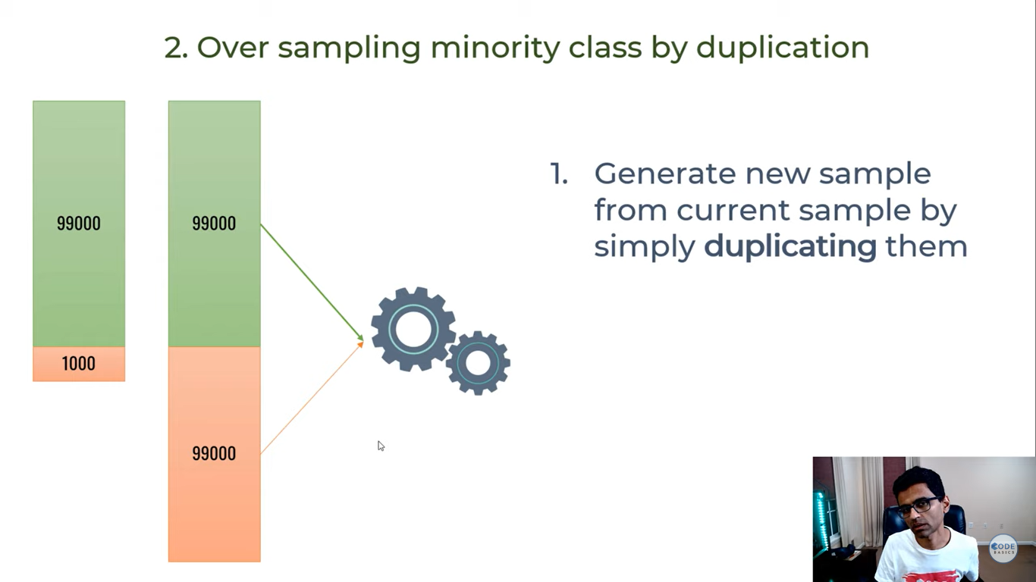

Slide 14
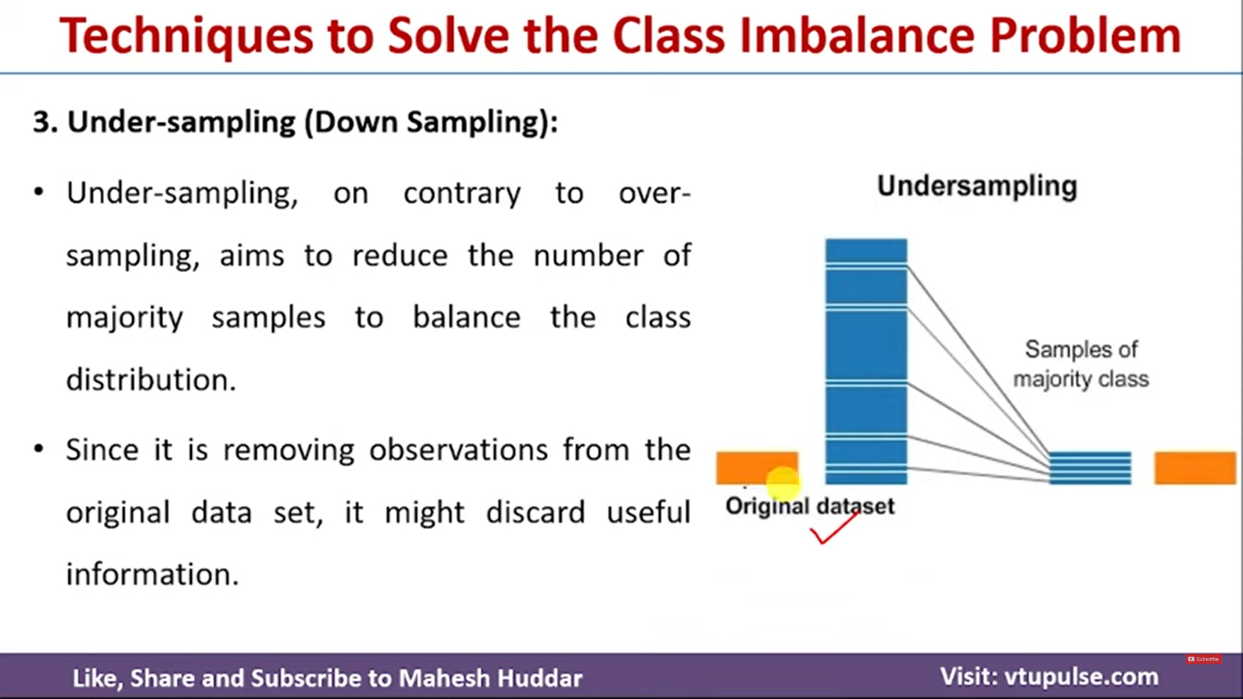
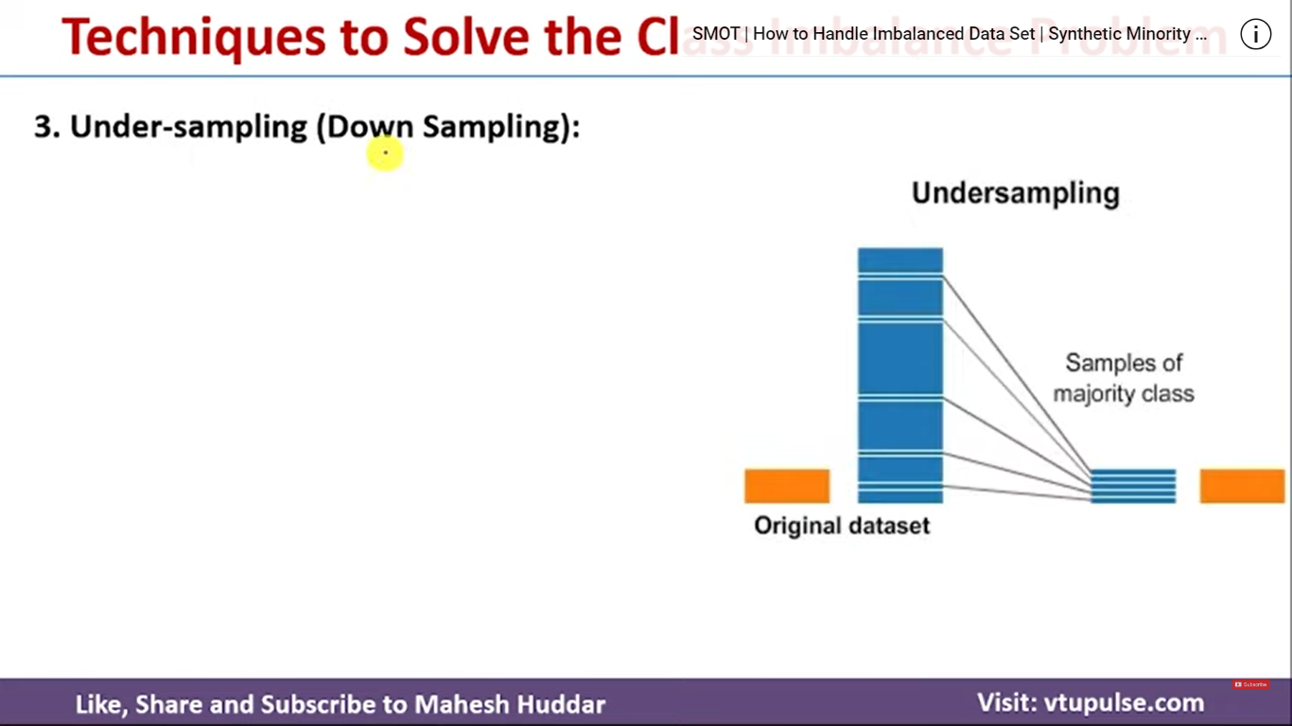

Slide 15
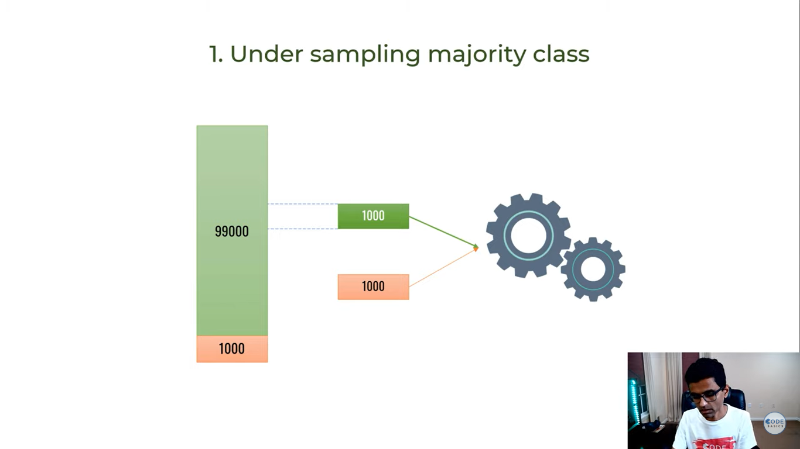
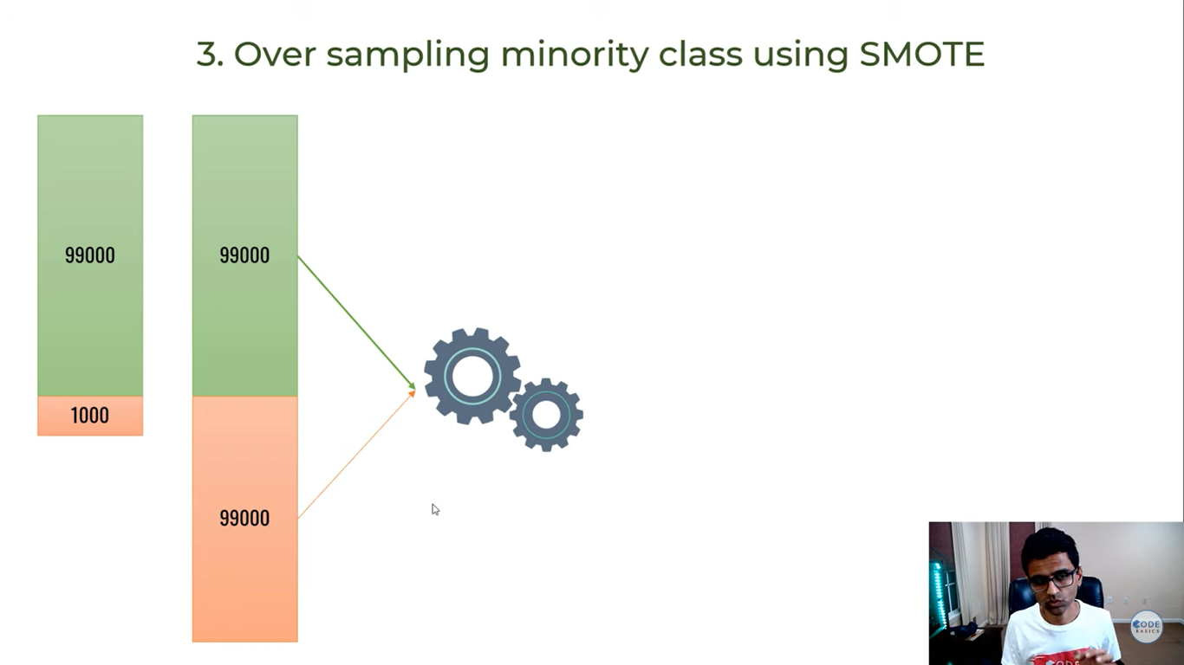

Slide 16
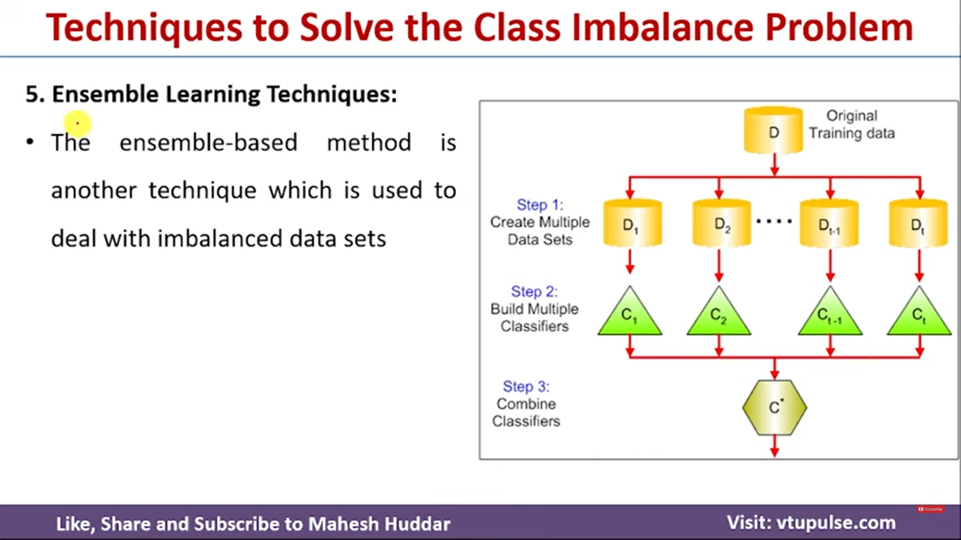
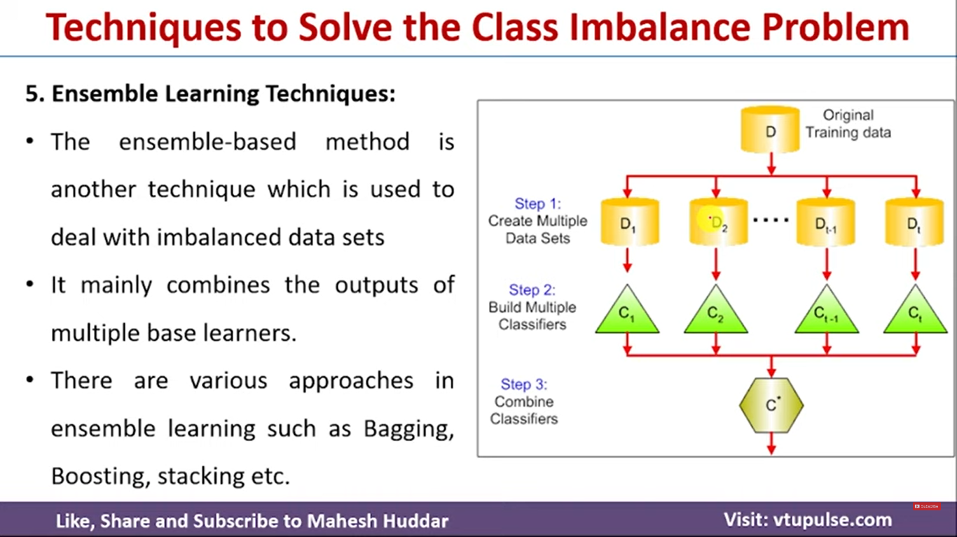
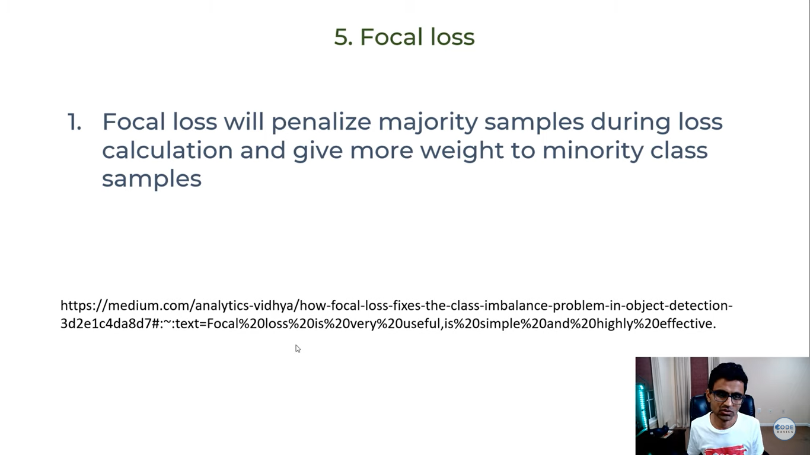

Slide 17
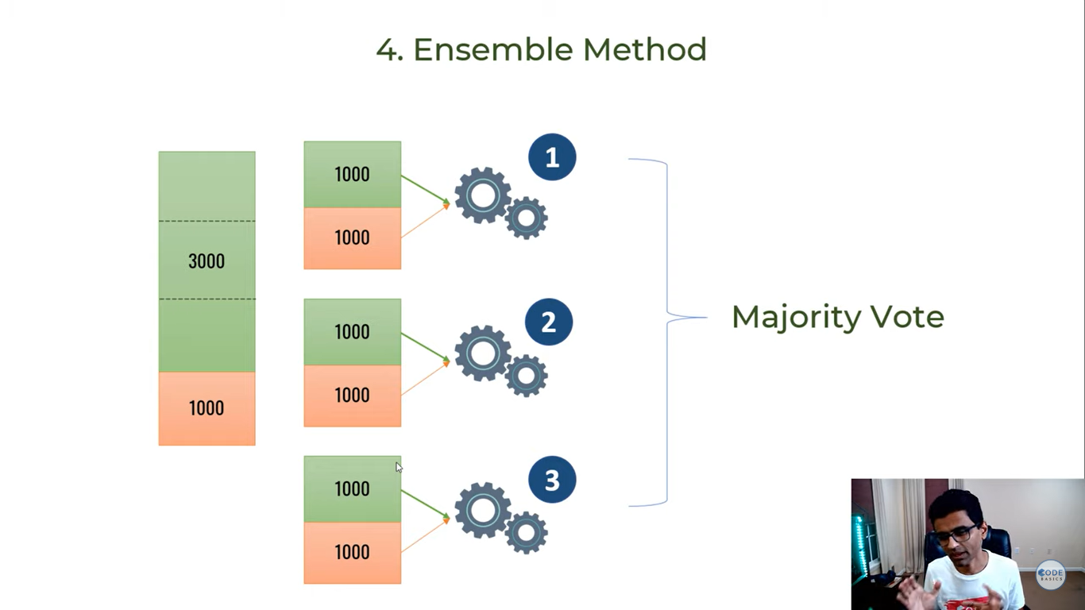

Slide 18
Managing Imbalanced Datasets
There are several techniques to handle imbalanced datasets, and two popular ones are Synthetic Minority Over-sampling Technique (SMOTE) and Random Under-Sampling (RUS). Additionally, using Feature Importance can help identify the most relevant features, which may improve model performance.

Slide 19
1. Synthetic Minority Over-sampling Technique (SMOTE)
SMOTE is an over-sampling technique that creates synthetic examples of the minority class to balance the class distribution.
Instead of simply duplicating minority class examples, SMOTE generates new synthetic data points by interpolating between existing ones.
This approach helps to avoid overfitting that can occur with simple oversampling methods.

Slide 21
How SMOTE works ?
For each minority class sample, SMOTE identifies its k-nearest minority class neighbors.
It randomly selects one or more of the k-nearest neighbors.
It generates new samples by taking a weighted average of the feature values between the original data point and its neighbors.

Slide 22
Pros of SMOTE:
Balances the dataset by generating synthetic examples.
Reduces the risk of overfitting compared to simple oversampling.
Can improve model performance for minority classes.
Cons of SMOTE:
Can increase the training time due to a larger dataset.
May introduce noise if not used carefully.
Might not work well with high-dimensional data where the Euclidean distance is less meaningful.

Slide 23
2. Random Under-Sampling (RUS)
Random Under-Sampling involves reducing the number of majority class samples to balance the class distribution. This is done by randomly removing instances of the majority class.

Slide 24
How RUS works?
Randomly select a subset of the majority class samples.
Remove the remaining majority class samples.
The dataset now has a balanced class distribution.

Slide 25
Pros of RUS:
Simple and easy to implement.
Reduces the size of the dataset, leading to faster training times.
Helps to balance class distribution effectively.
Cons of RUS:
Potential loss of important information due to random removal.
Risk of underfitting the model due to fewer training examples.
Can result in poor generalization if too much data is removed.

Slide 26
3. Feature Importance
Feature Importance helps identify which features are most relevant for predicting the target variable.
This can be crucial in imbalanced datasets because not all features contribute equally to distinguishing between classes.
By focusing on the most important features, we can potentially improve the model's ability to classify minority classes correctly.

Slide 27
How to measure Feature Importance ?
Tree-based methods: Decision Trees, Random Forests, and Gradient Boosting Trees inherently provide feature importance scores based on how well each feature splits the data.
Permutation Importance: This involves shuffling the values of each feature to observe the impact on the model's performance. A significant drop in performance indicates a high feature importance.
SHAP Values (SHapley Additive exPlanations): A more advanced method that provides insight into the contribution of each feature to each prediction made by the model.

Slide 28
Using Feature Importance with SMOTE and RUS:
Identify the most important features using feature importance methods.
Apply SMOTE to the minority class, focusing on maintaining the balance of the important features.
Apply RUS to the majority class, ensuring that the important features are well represented even after under-sampling.
This combined approach ensures that the model is trained on balanced data without losing important information.

